Slide 1
Efficient AES Implementations on ASICs & FPGAs
Norbert Pramstaller, Stefen Mangard, Sandra Dominikus and Johannes Wolkerstorfer

Slide 2
Introduction
Why do we need dedicated hardware implementation for AES ?
High speed communication link
It’s easier to secure a small AES module than an entire processor
Reduce the power consumption

Slide 3
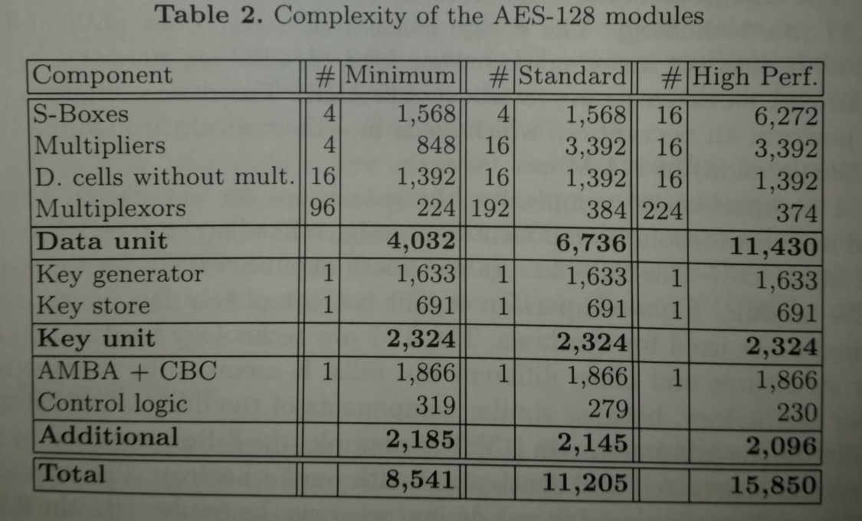
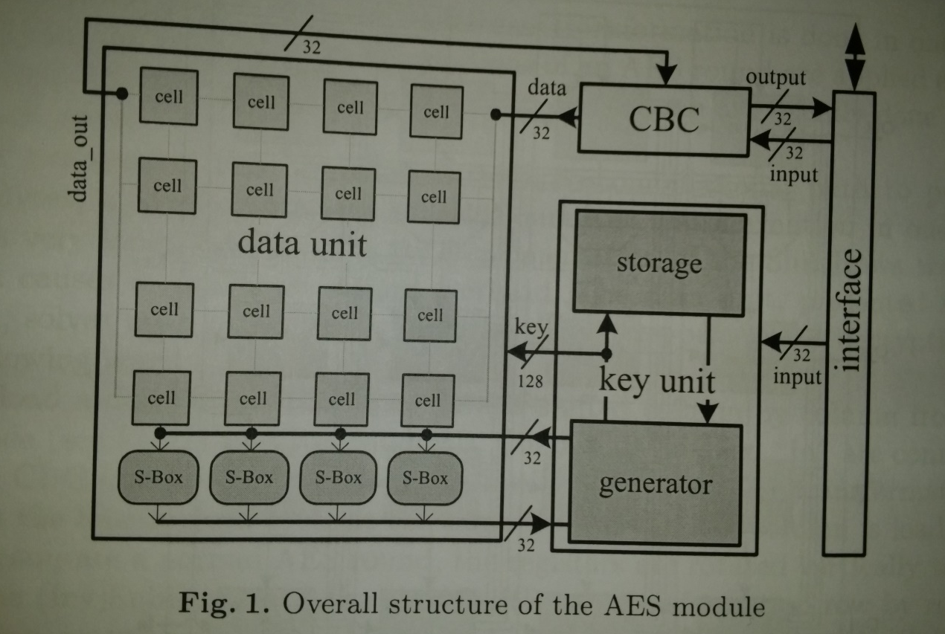
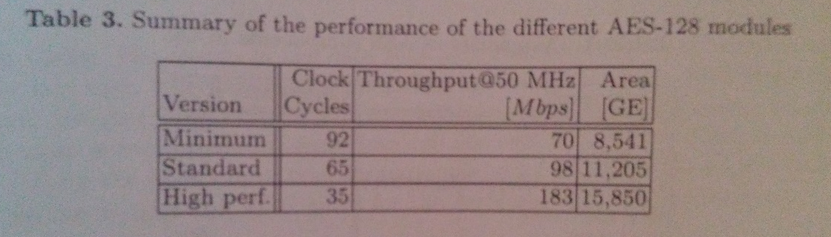
Asic Implementation of aes

Slide 4
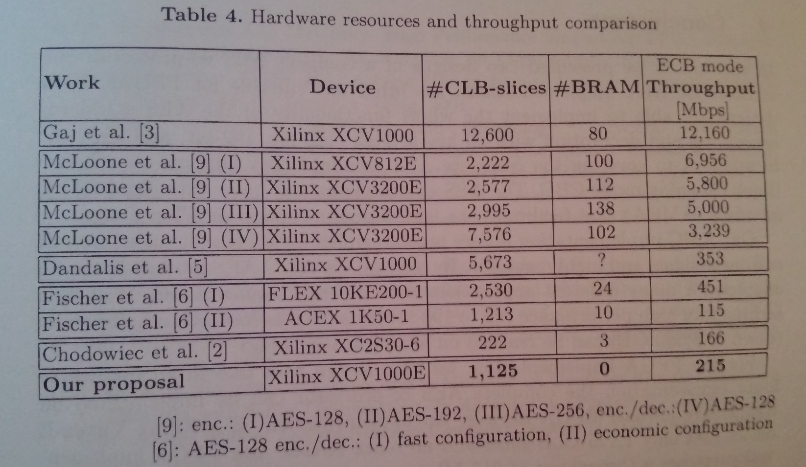
FPGA Implementation of aes

